Slide 1
WEFOLLOW: A Corporate Social Network
Submitted By:
Satbir Chauhan
CSE 8th sem
IGCE, Abhipur(Mohali)

Slide 2
Statement About Problem
Why is WeFollow being created? I mean, do we really need Twitter inside organizations too? The use of social media technologies—such as blogs, wikis, social networking sites, social tagging, and microblogging—is proliferating at an incredible pace. In many organizations team wants and needs features that many social networks offer but needed them within a secure and private area. It is a tool built to essentially solve their own problem. You can quickly see updates from everyone, those you are following, or direct messages you have received or sent. From here you can post replies, view a thread, forward messages.

Slide 3
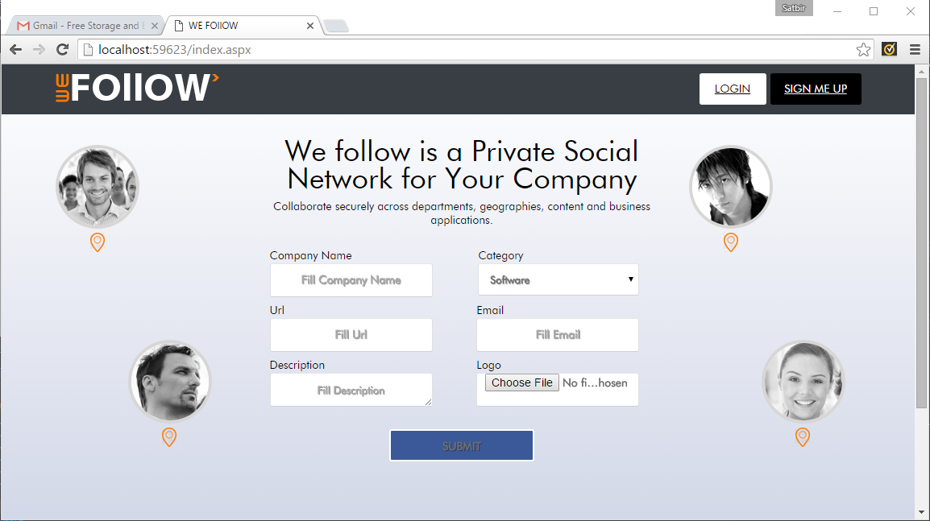
Front End
Sign up for Company

Slide 4
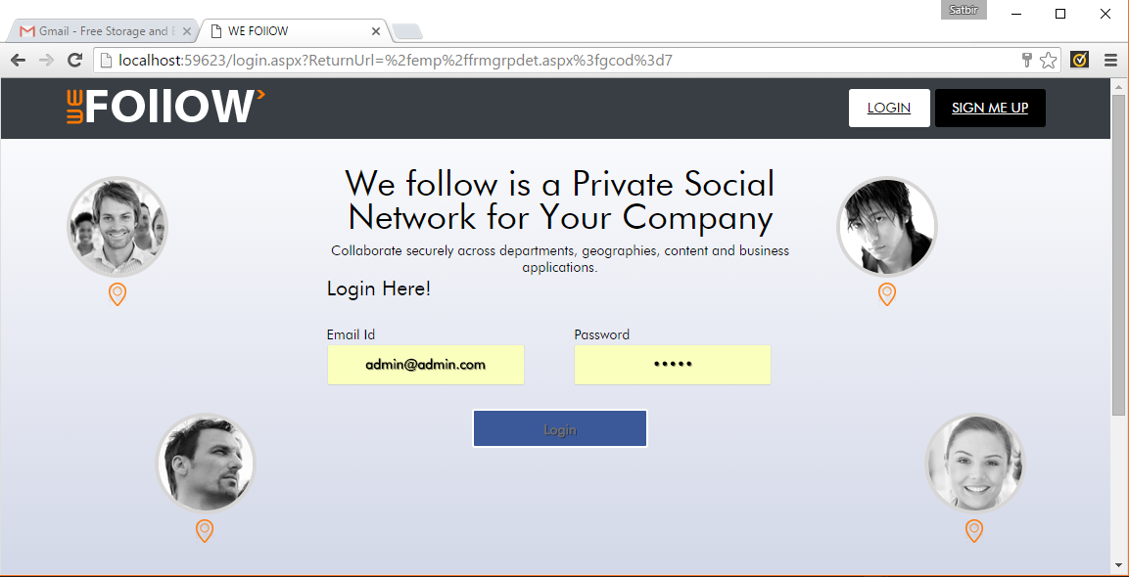
Login From Here

Slide 5
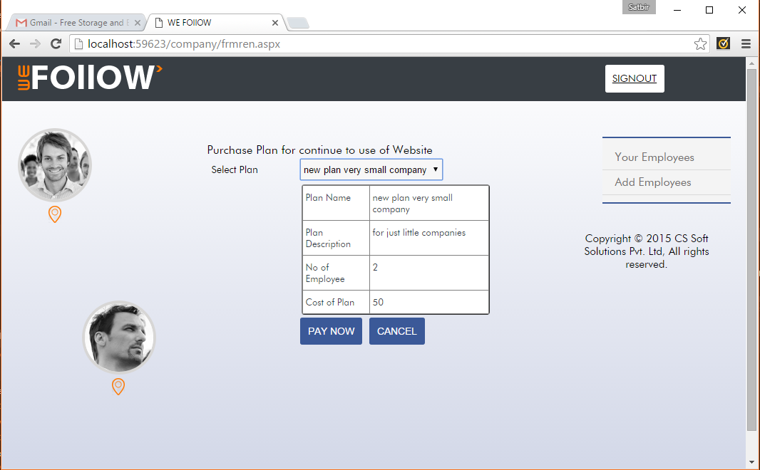
Company Panel
Purchase Plan

Slide 6
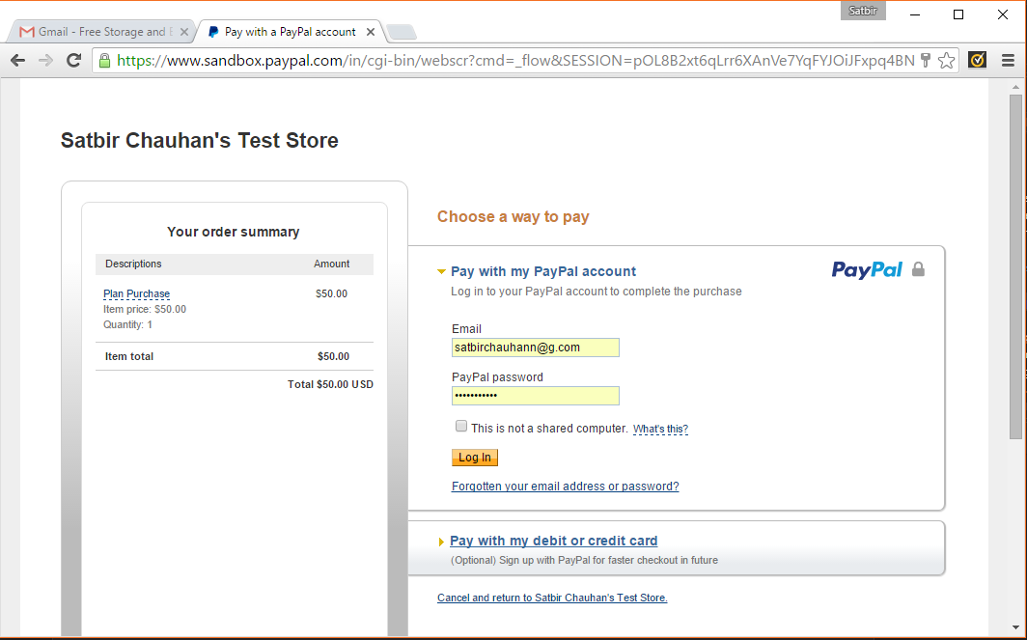
Paypal Page

Slide 7
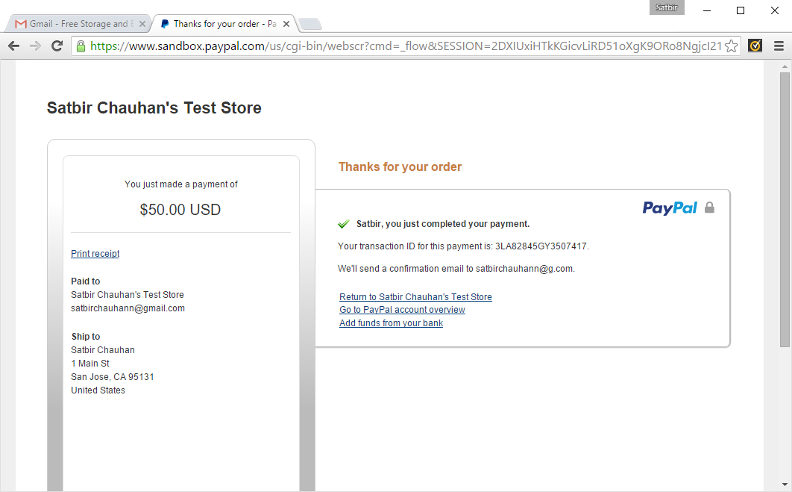
Successful Payment made on Gateway

Slide 8
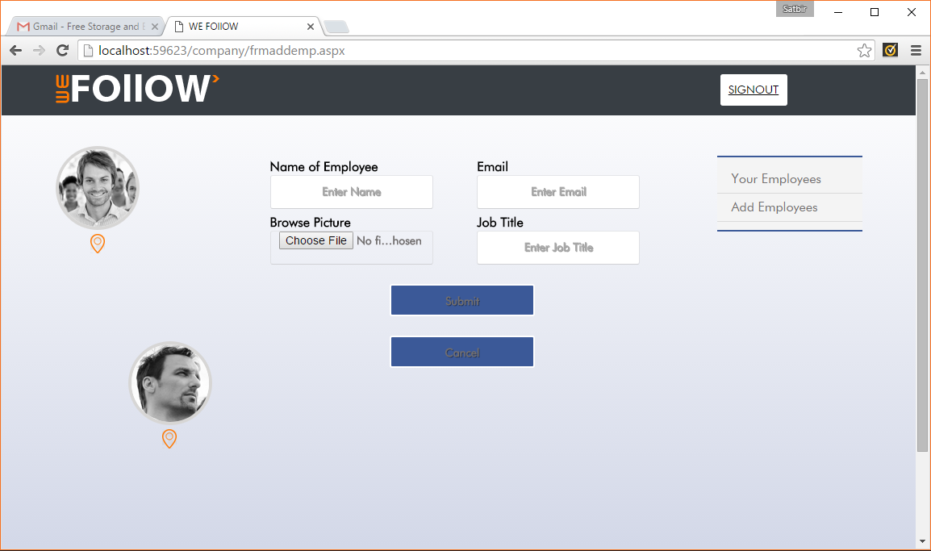
Add Employees

Slide 9
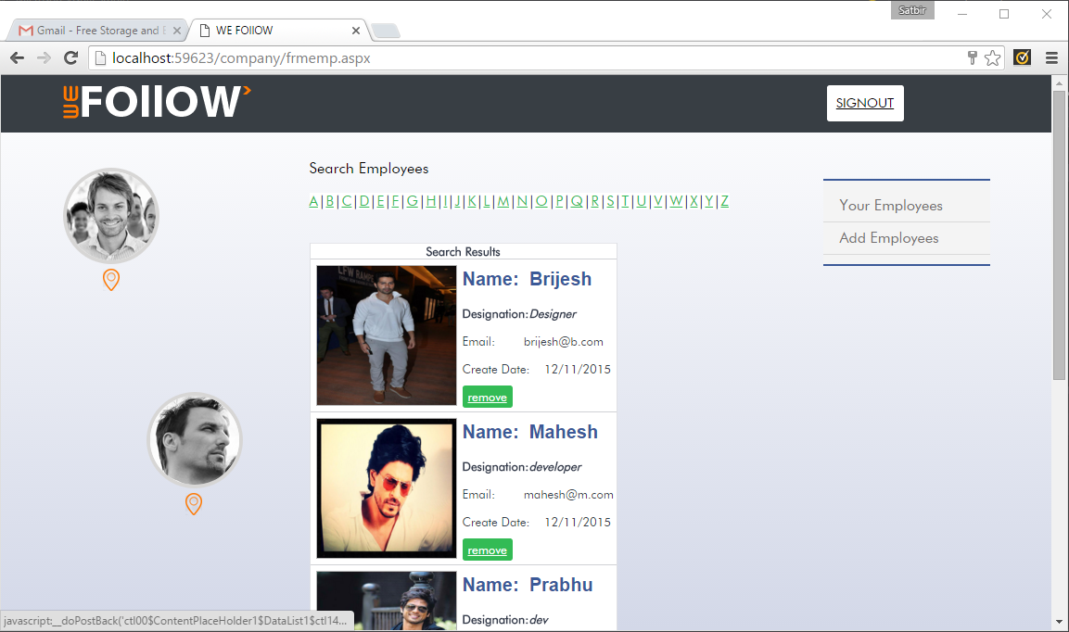
Remove Employee

Slide 10
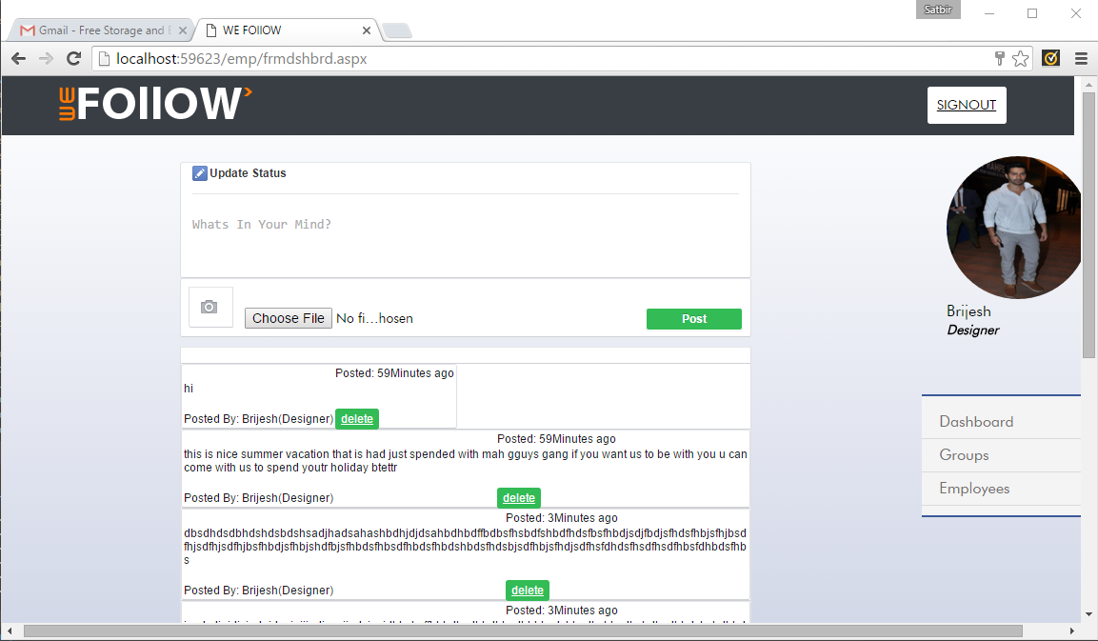
Employee Dashboard

Slide 11
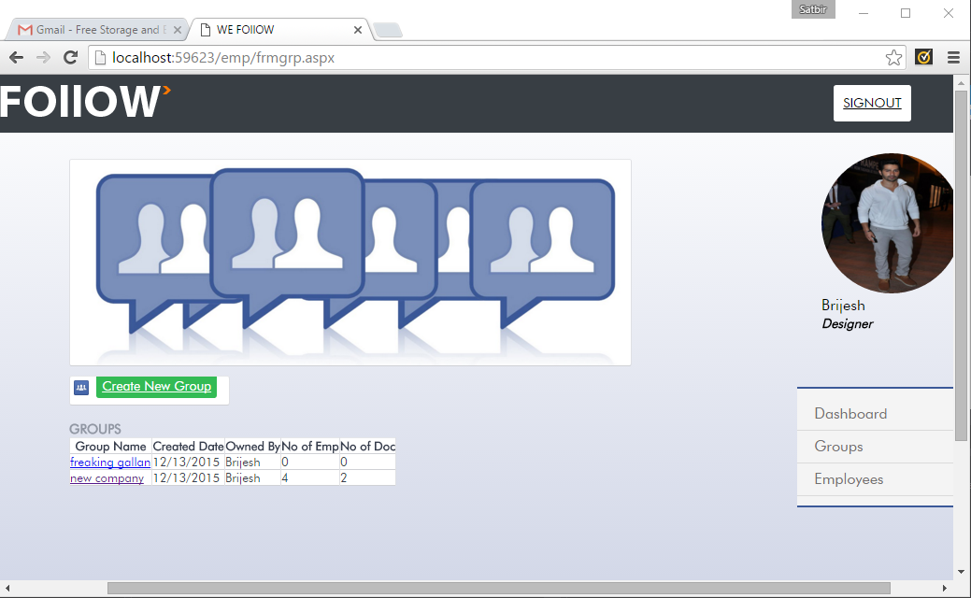
Group Page

Slide 12
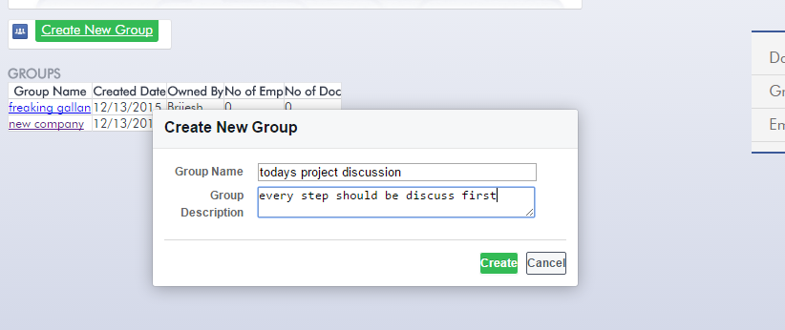
Create Group

Slide 13
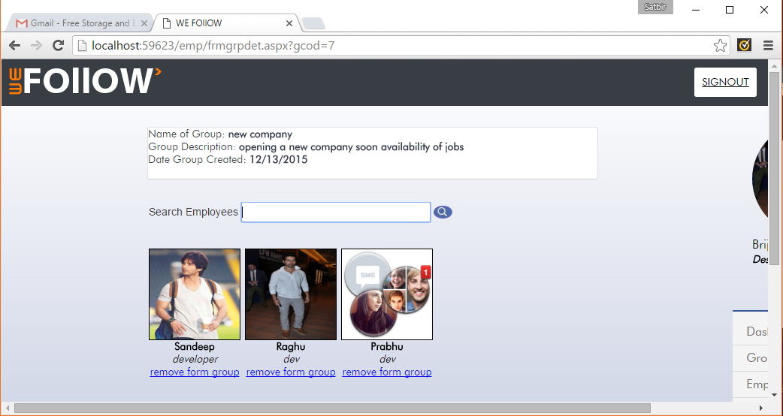
Group Detail Page

Slide 14
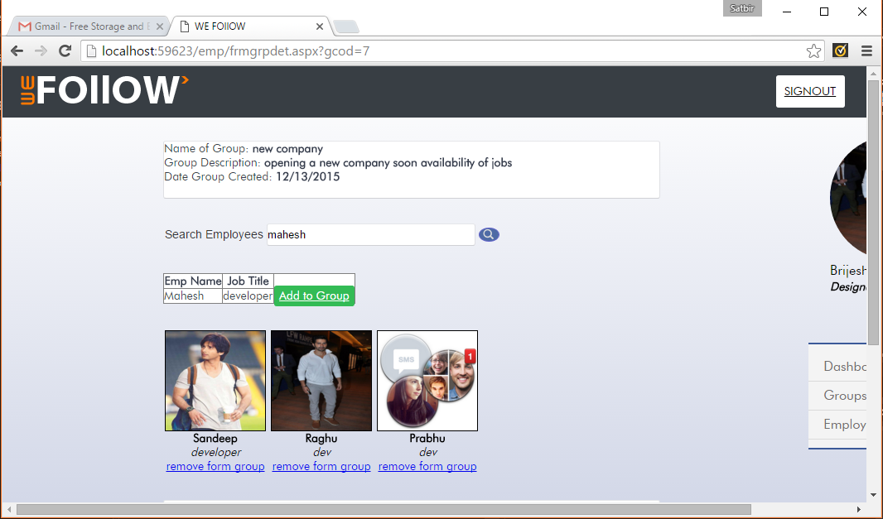
Search Result
Search Employee & add to Group

Slide 15
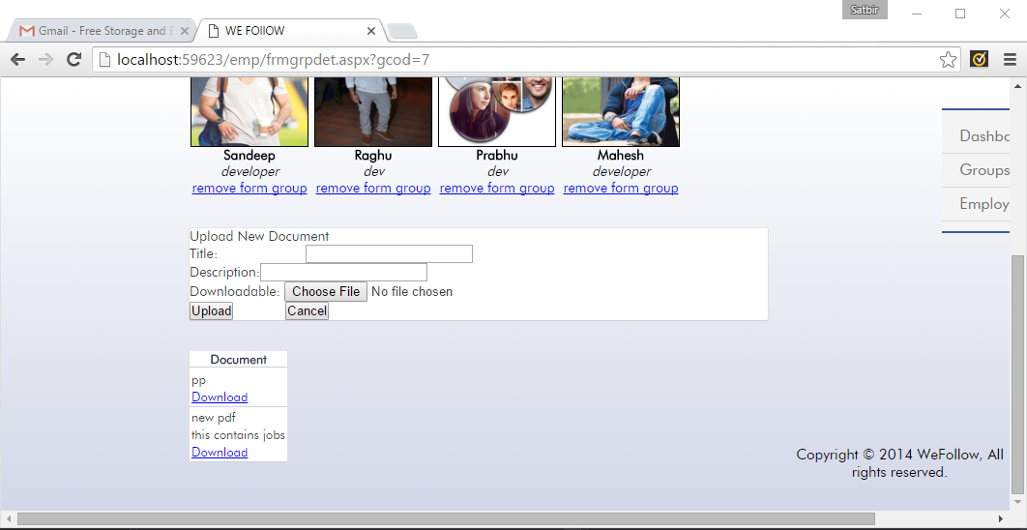
Upload Documents

Slide 16
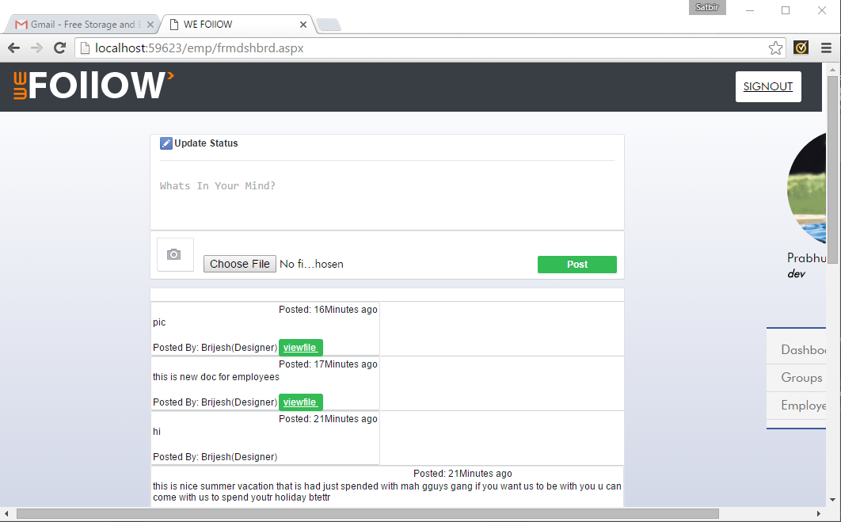
Followers Dashboard

Slide 17
Thanks

